Slide 1
Bulk RNA-seq vs DNA-seq Analysis
Ngày 10 tháng 05 năm 2025
TS. Lưu Phúc Lợi
Email: luu.p.loi@googlemail.com
Zalo: 0901802182

Slide 2
Content
Aim of the methods
Library prep for RNA-seq
Upstream Analysis Workflow
Downstream Analysis Workflow
From BAM to Count
Differential Gene Expression
Enrichment of DEGs with Over Representation Analysis (ORA)
RNA-seq databases: GTEx and TCGA

Slide 3
Aim of the methods
Bulk DNA-seq?
Bulk RNA-seq?

Slide 4
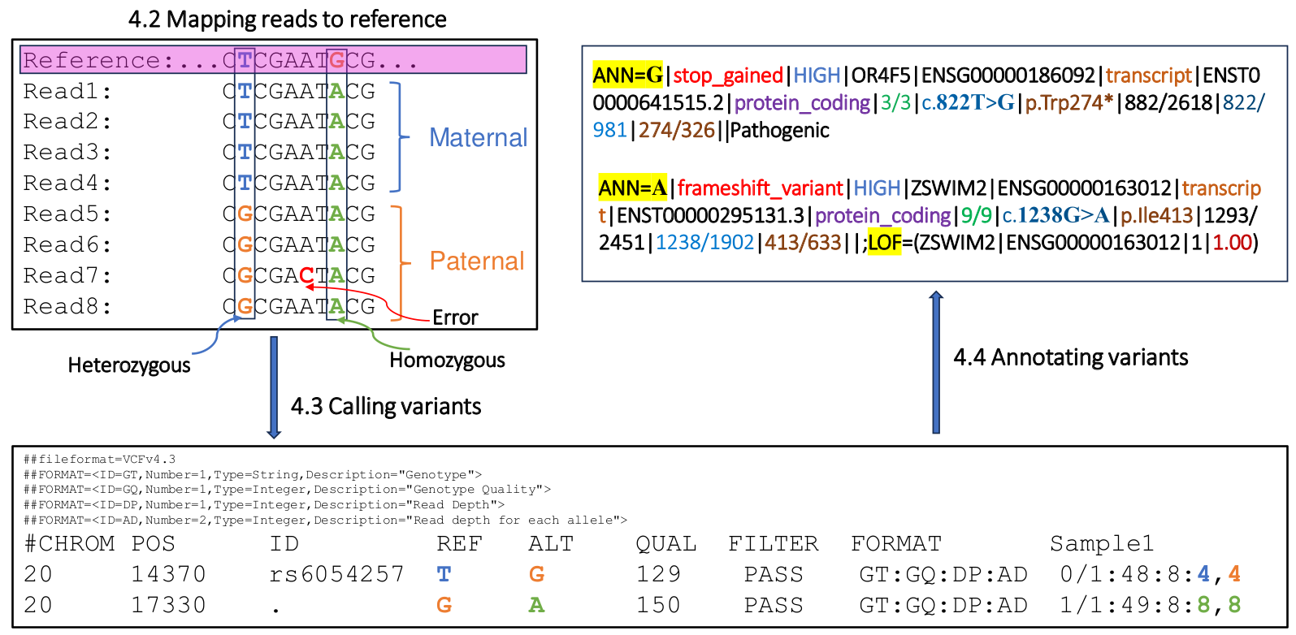
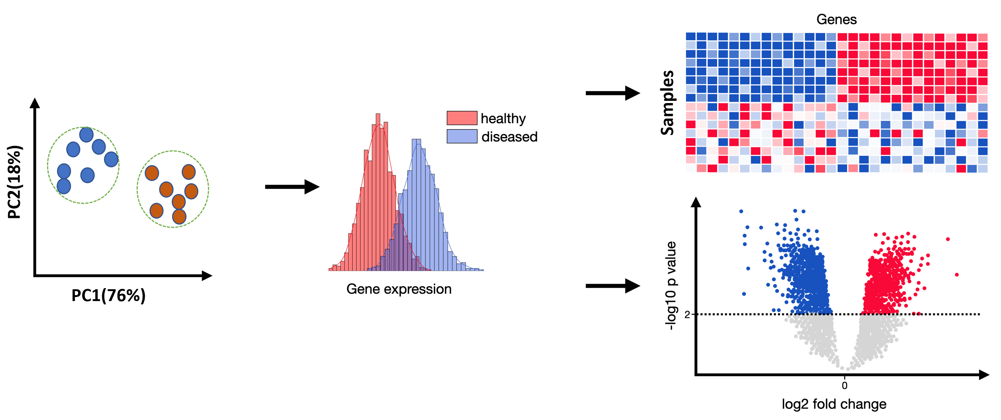
Aim of the methods
Bulk DNA-seq
Bulk RNA-seq

Slide 5
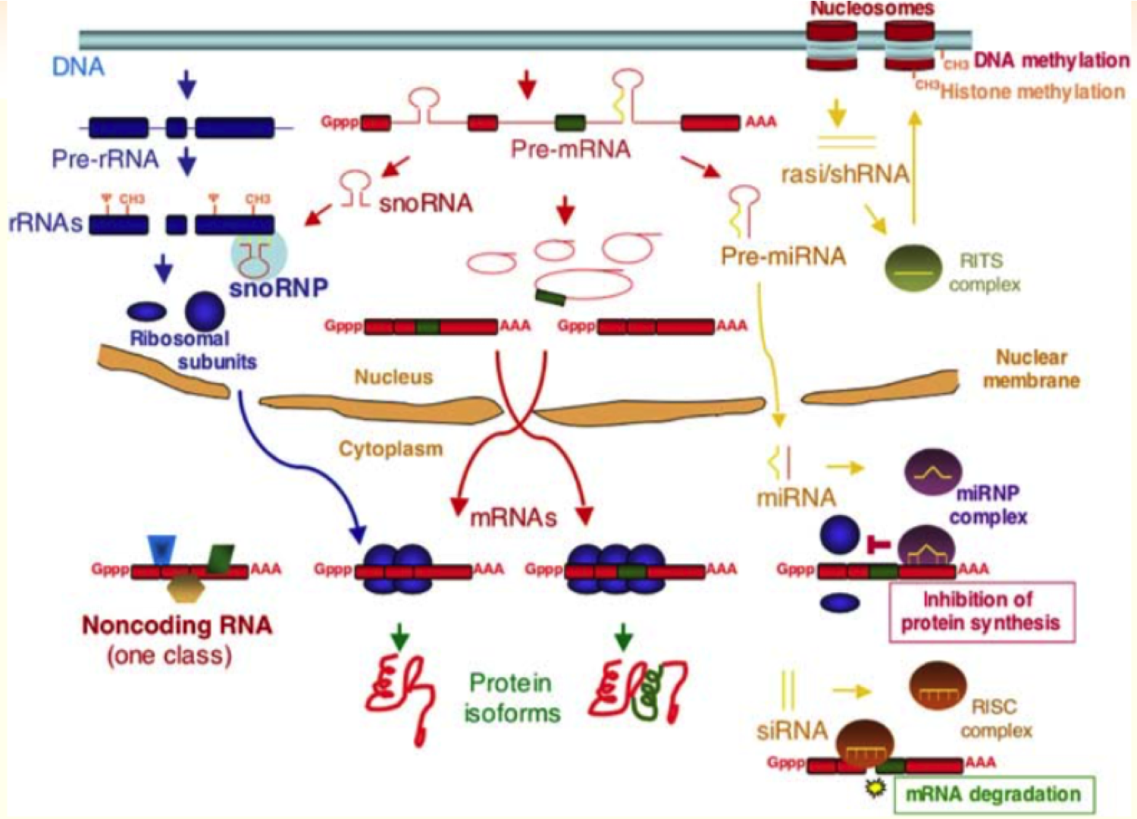
Different types of RNA

Slide 6
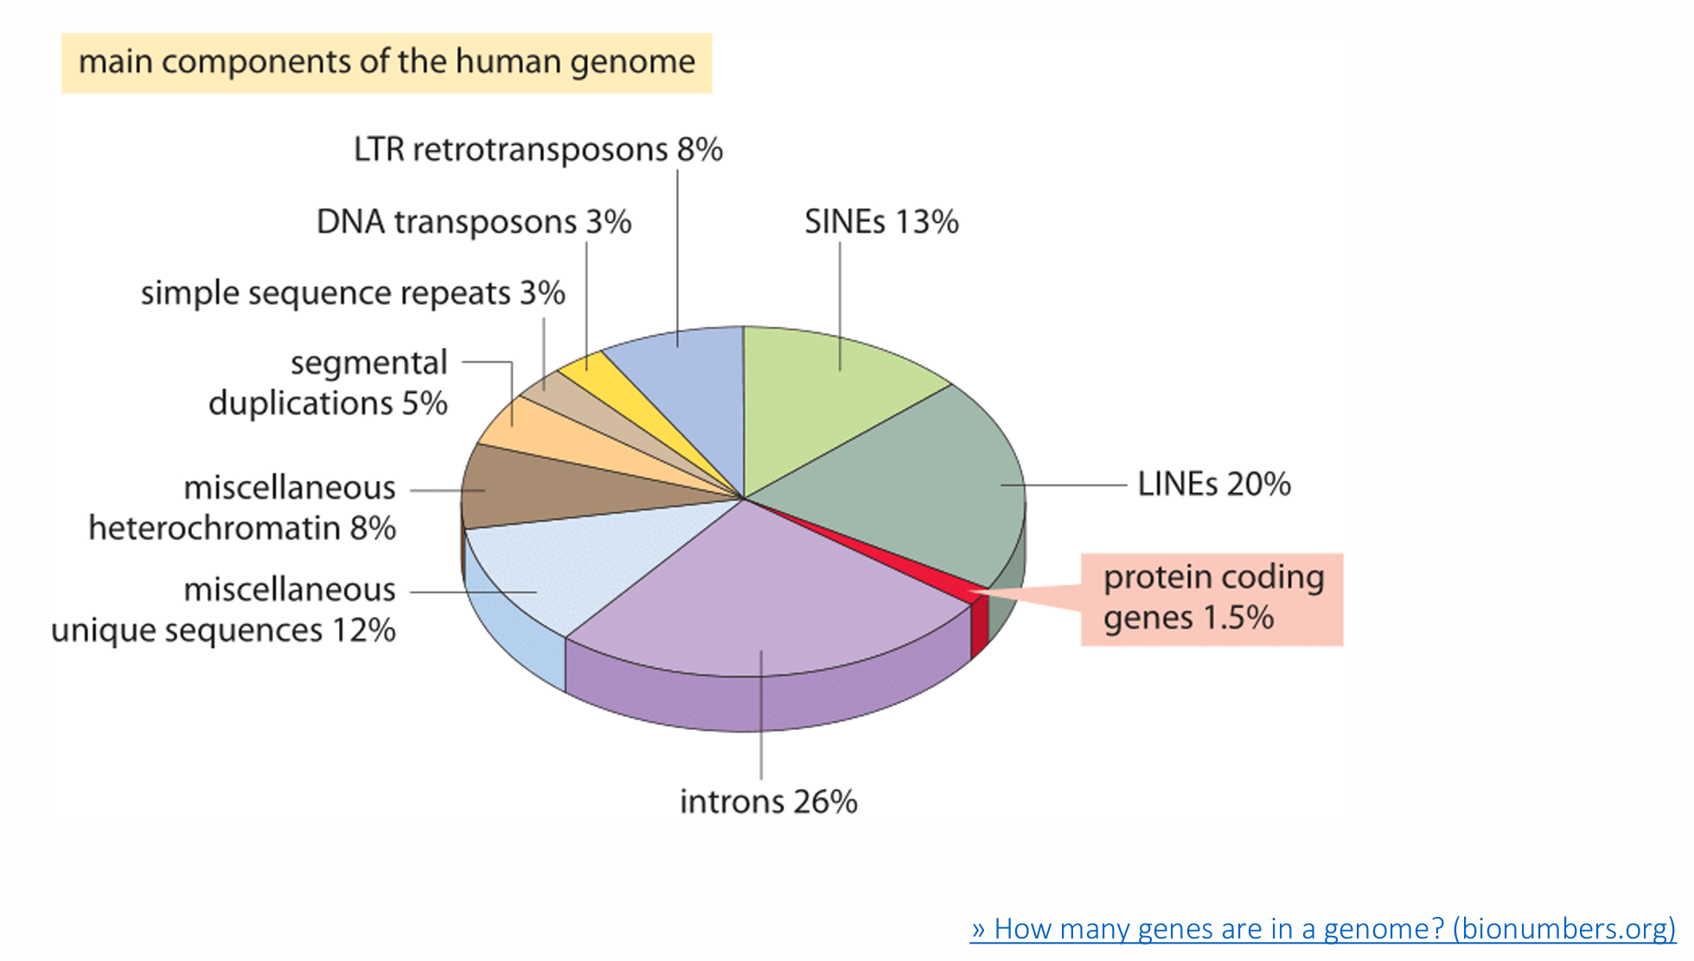
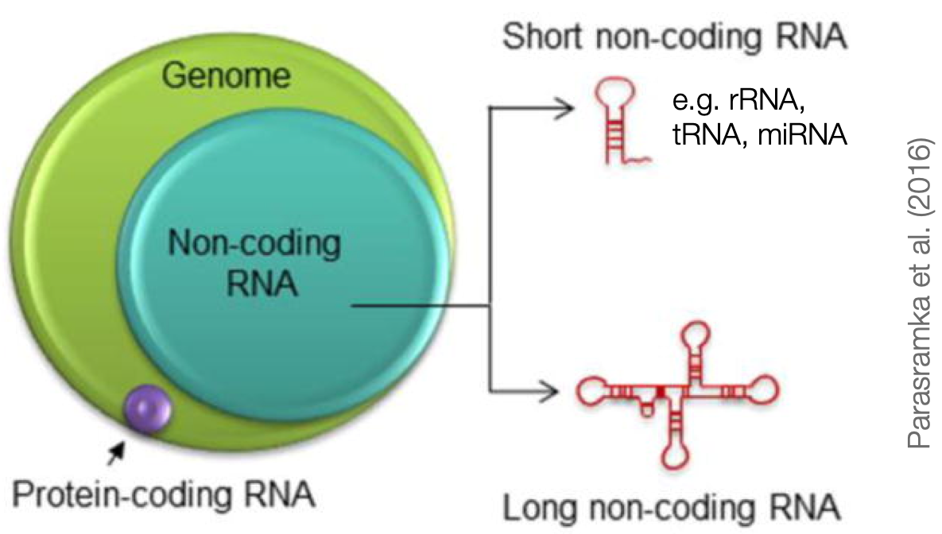
Different types of RNA

Slide 7
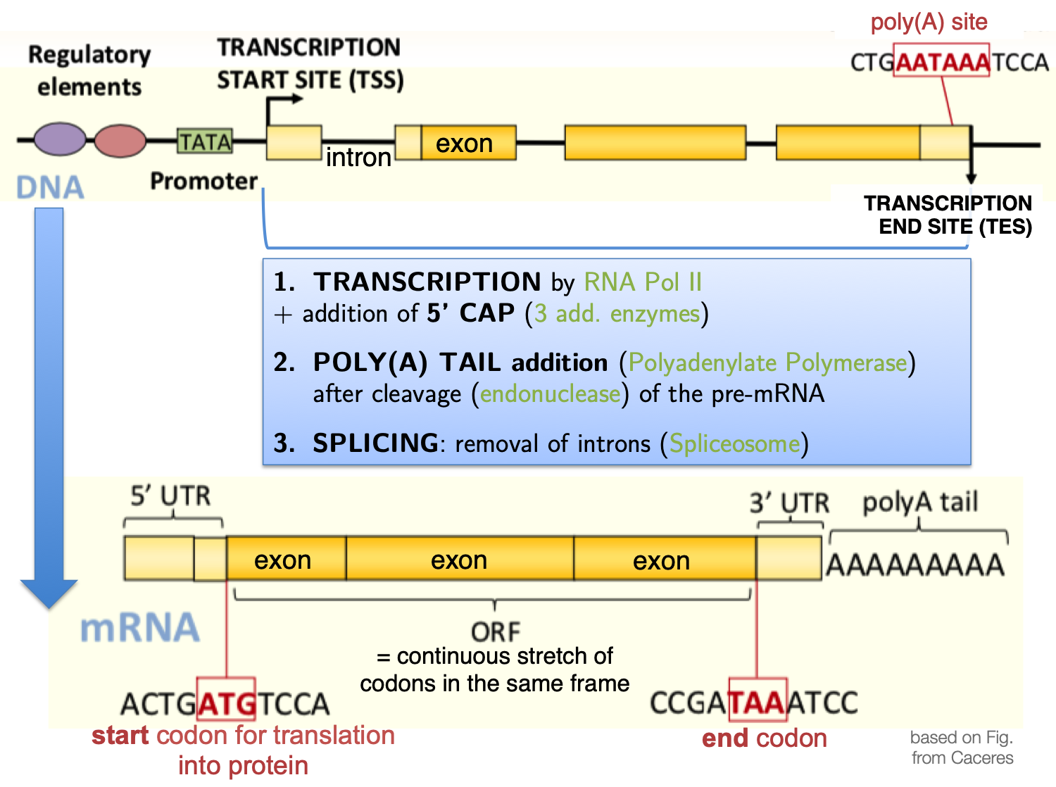
Sequencing library prep protocol depends on the RNA properties
It is not a one-size-fits-all situation!
Abundance and stability
rRNA: 90-95% (!)
tRNA: 3-5%
mRNA: 2%
all other non-coding RNAs: well below 1%
Cellular location
most are in the cytoplasm
Size
miRNAs: 18-23bp
mRNA: several 100 to 1000 bp
Specific sequences/modifications
poly(A) tails of mRNA
2D structure
antisense transcripts

Slide 8
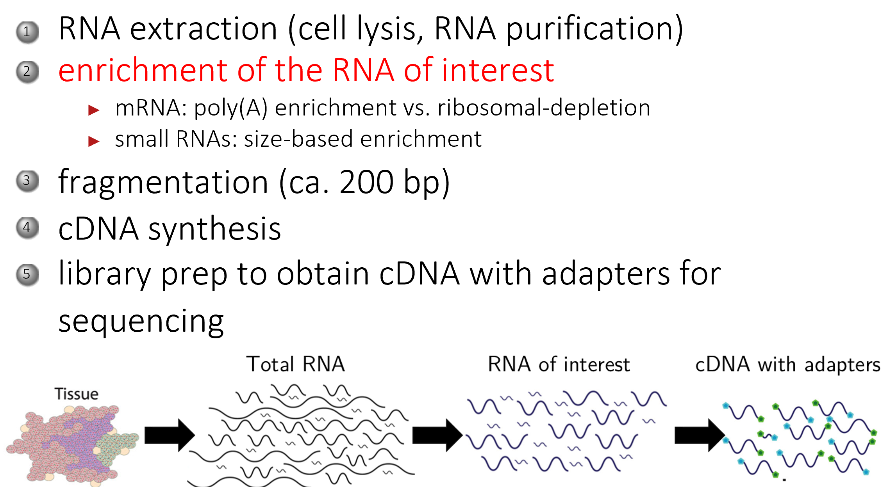
General steps of RNA-seq preparation

Slide 9
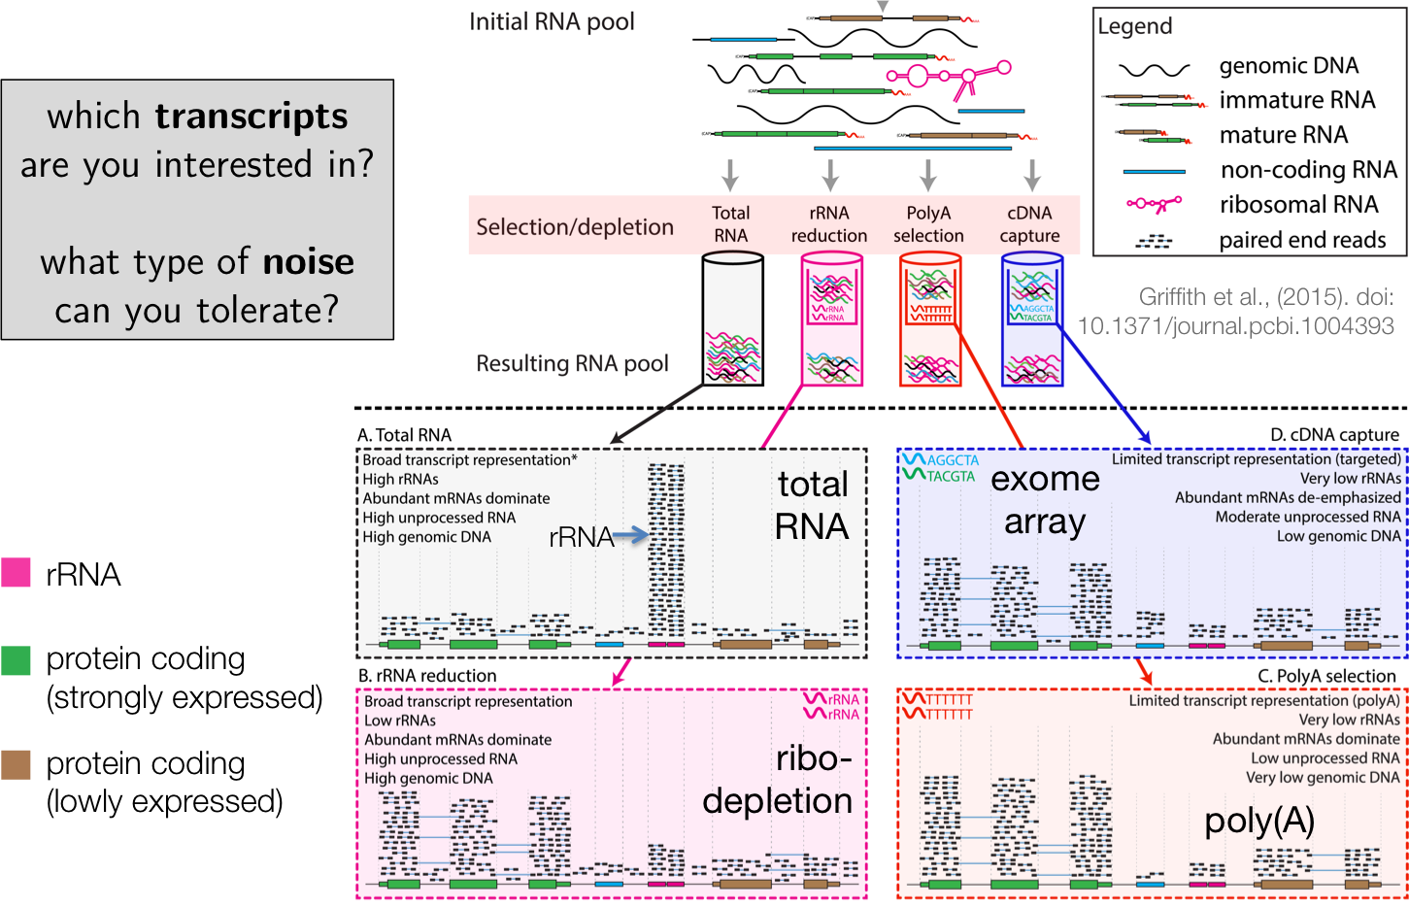
General steps of RNA-seq preparation

Slide 10
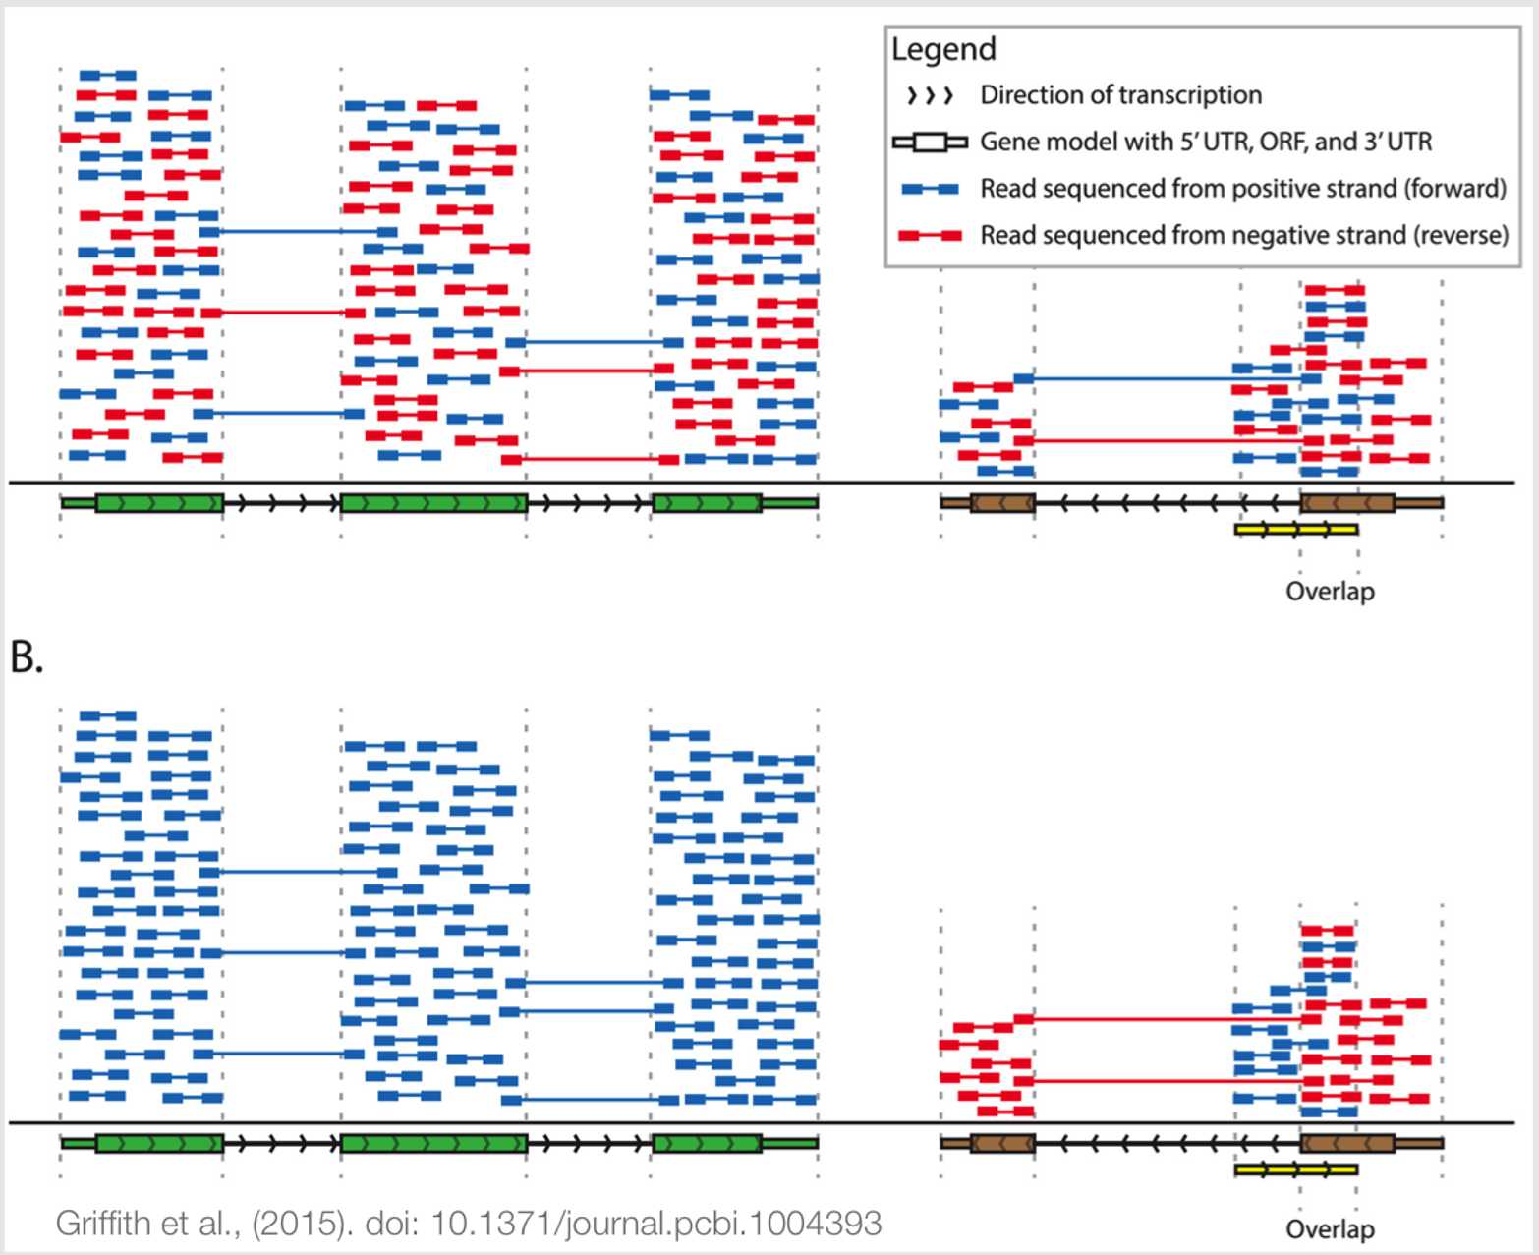
A.
Non-stranded
Stranded

Slide 11
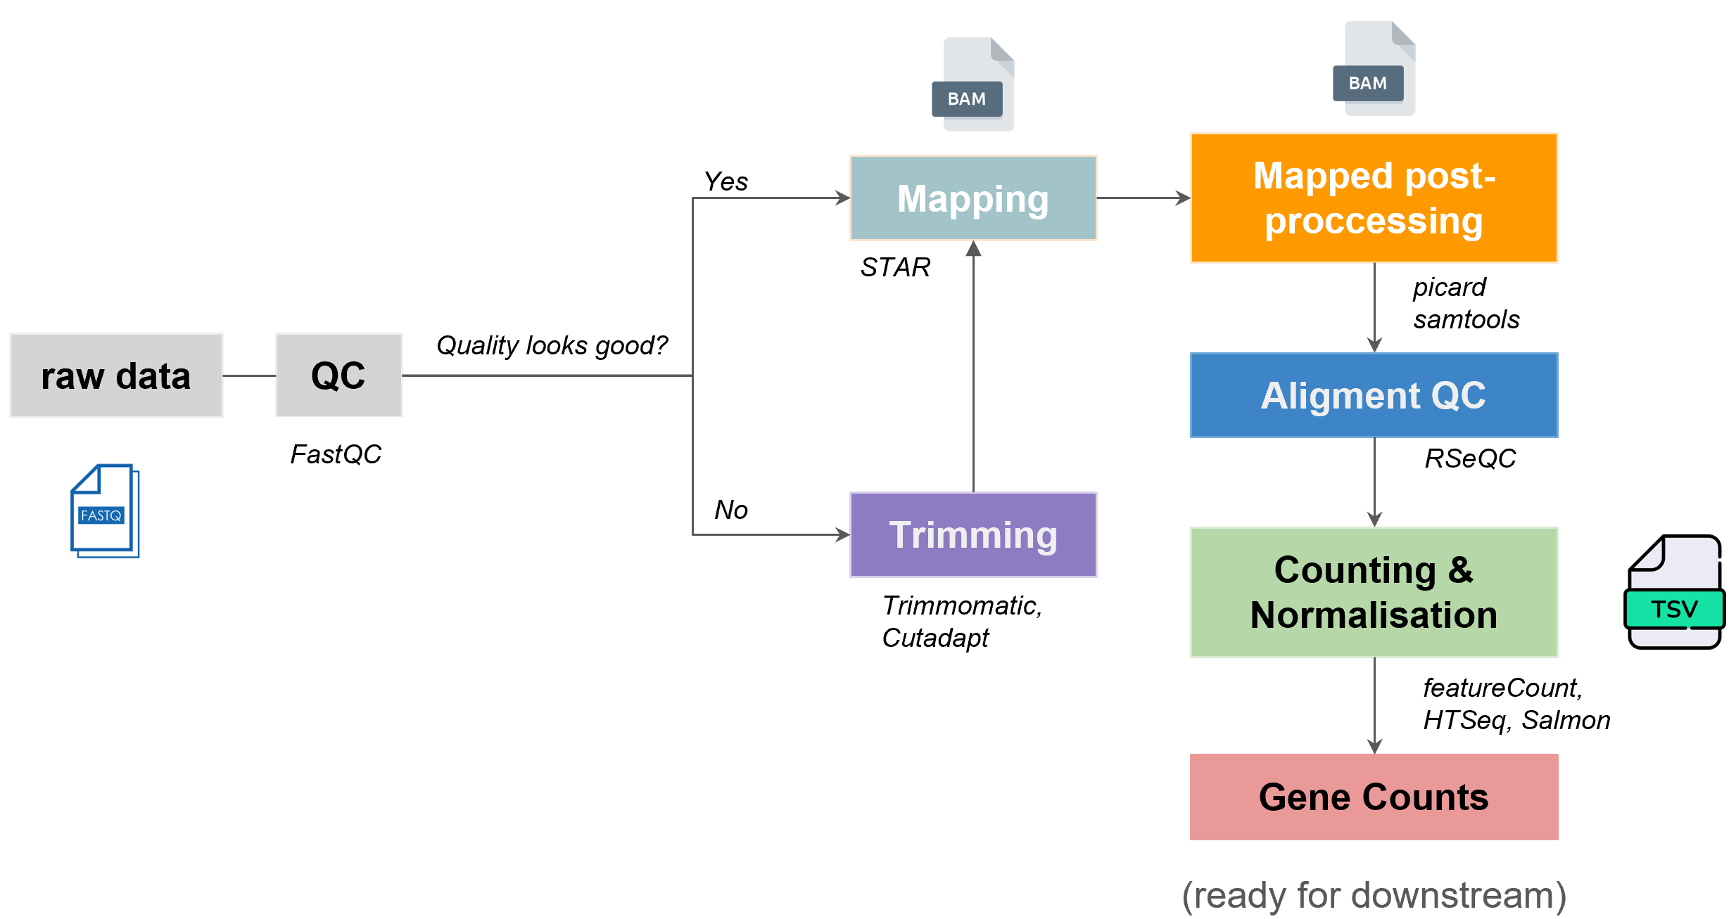
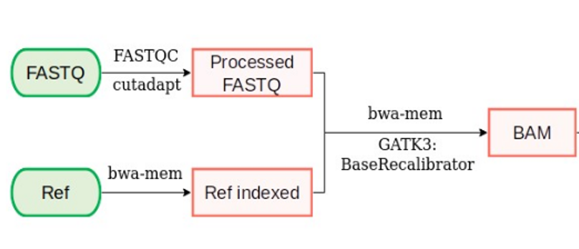
Upstream Analysis Workflow
Bulk DNA-seq
Bulk RNA-seq

Slide 12
Upstream Analysis Workflow
Bulk DNA-seq
Bulk RNA-seq
Where are the References need? And what are these?

Slide 13
Upstream Analysis Workflow
Bulk DNA-seq
Bulk RNA-seq
Where are the References need? And what are these?

Slide 14
Upstream Analysis Workflow
Bulk DNA-seq
Bulk RNA-seq
Human Genome Sequences can be found at UCSC, NCBI and Ensembl and GENCODE as fasta format
The four most common gene annotation databases are currently RefSeq, UCSC, Ensembl and GENCODE as GTF format

Slide 15
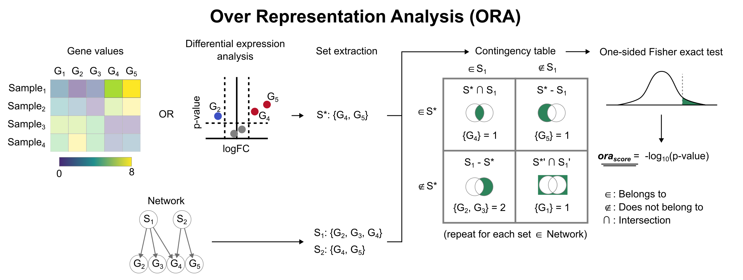
Differential Gene Expression
Normal
Tumor

Slide 16
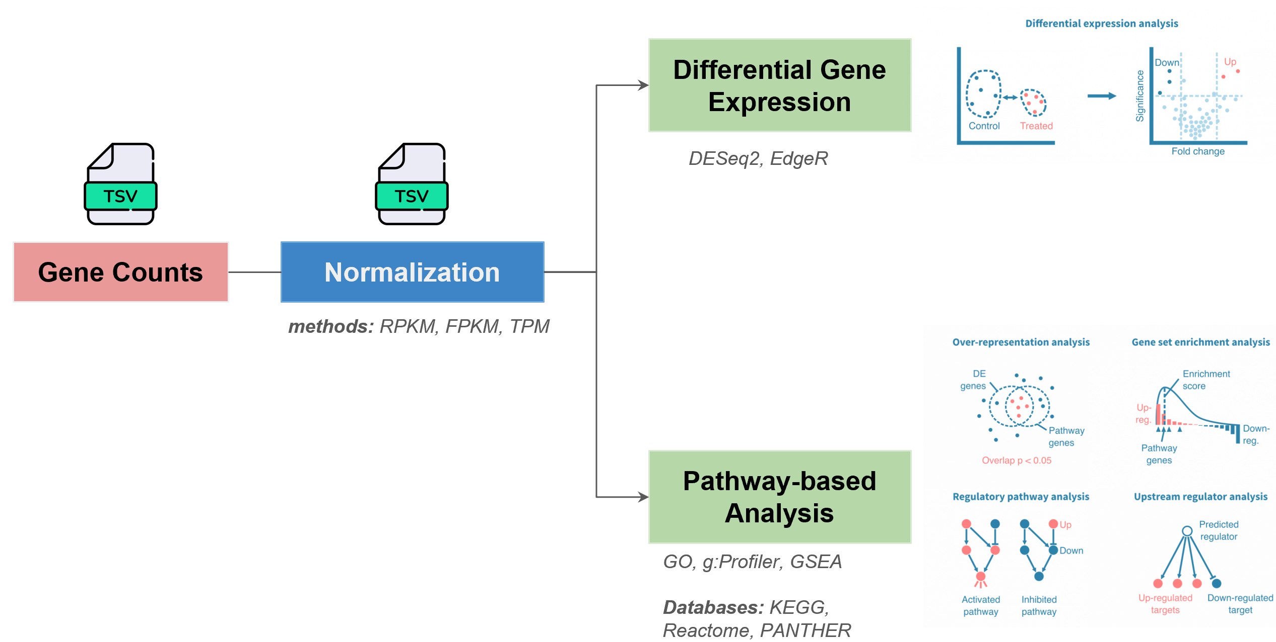
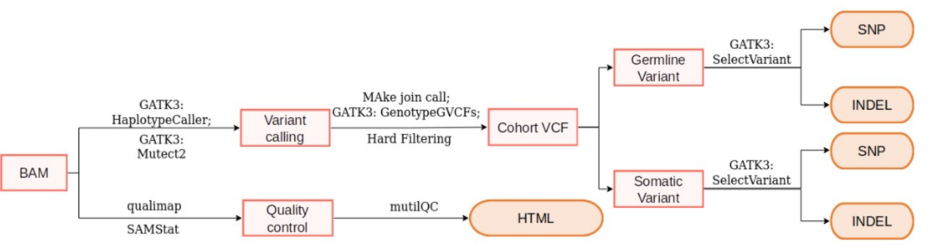
Downstream Analysis Workflow
Bulk DNA-seq
Bulk RNA-seq

Slide 17
Downstream Analysis Workflow
Bulk DNA-seq
Bulk RNA-seq
What is the unmatch?

Slide 18
Downstream Analysis Workflow
Bulk DNA-seq
Bulk RNA-seq
What is the unmatch?

Slide 19
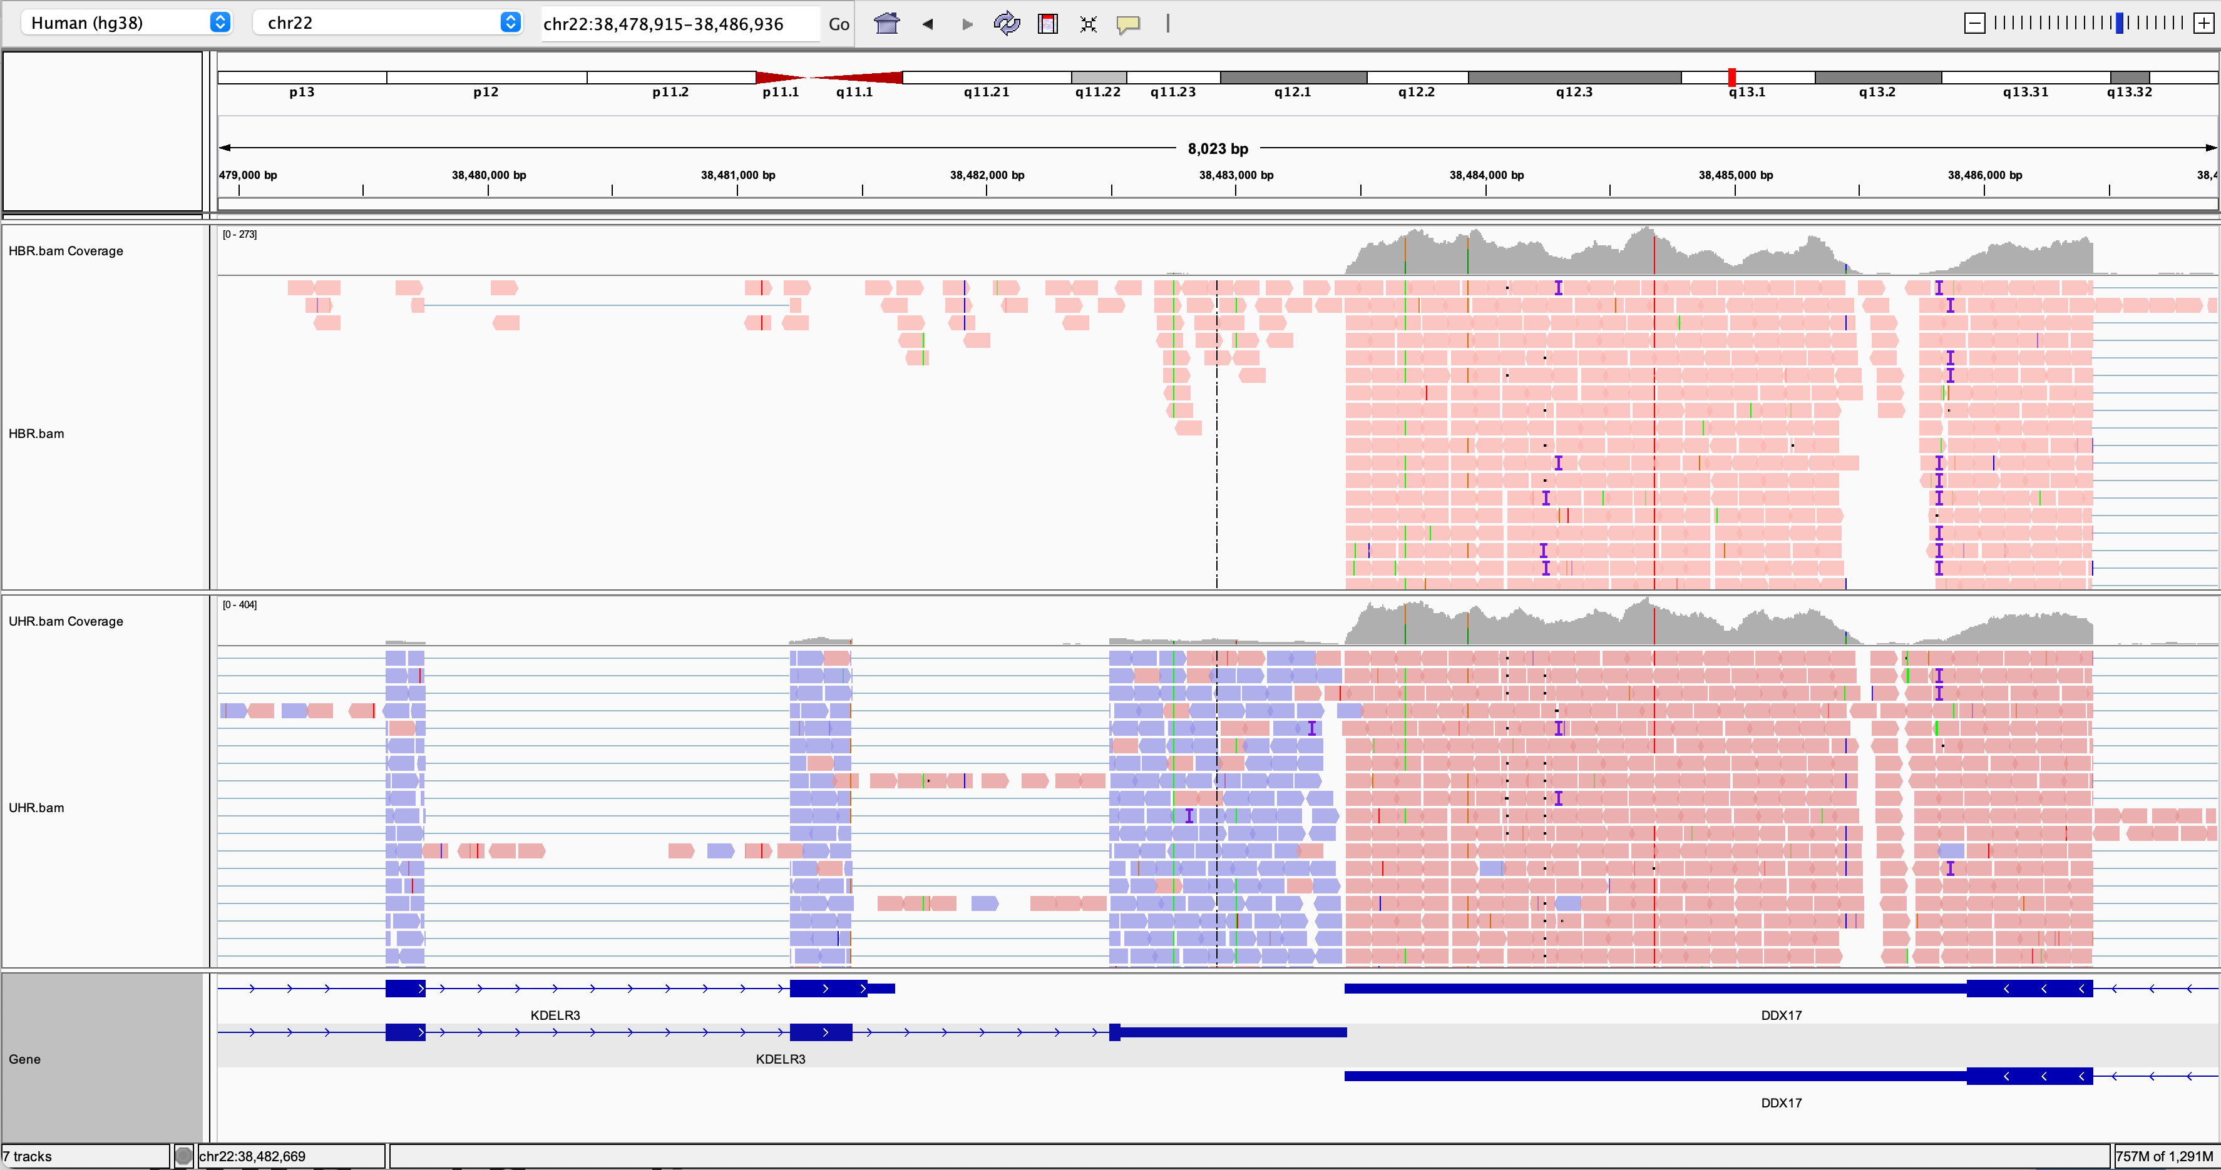
From BAM to Count
Gene | Sample 1 Healthy | Sample 2 Healthy | Sample 3 Healthy | Sample 4 Tumor | Sample 5 Tumor | Sample 6 Tumor
A | 100 | 101 | 105 | 160 | 163 | 154
B | 10 | 8 | 9 | 1 | 2 | 3
C | 45 | 45 | 45 | 46 | 46 | 46
D | 0.11 | 0.12 | 0.13 | 0.0012 | 0.0014 | 0.0013

Slide 20
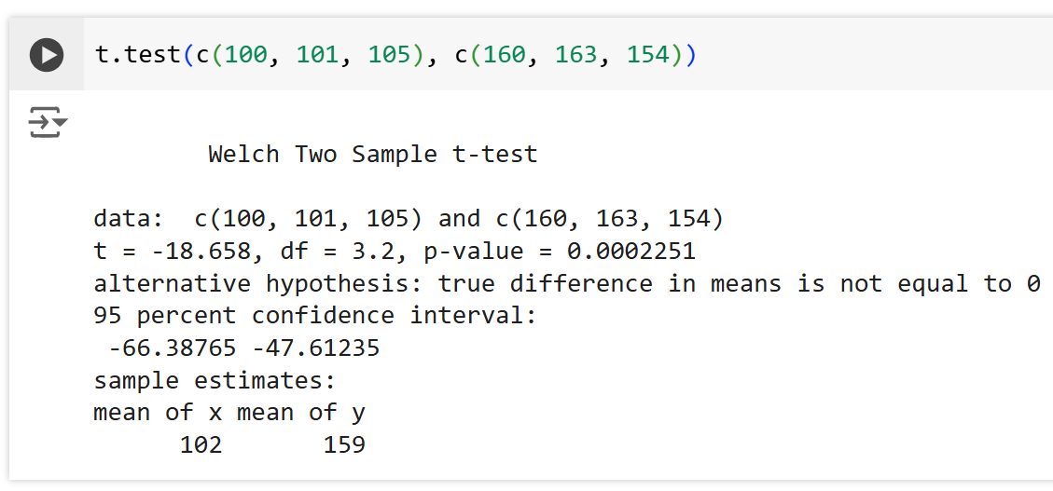
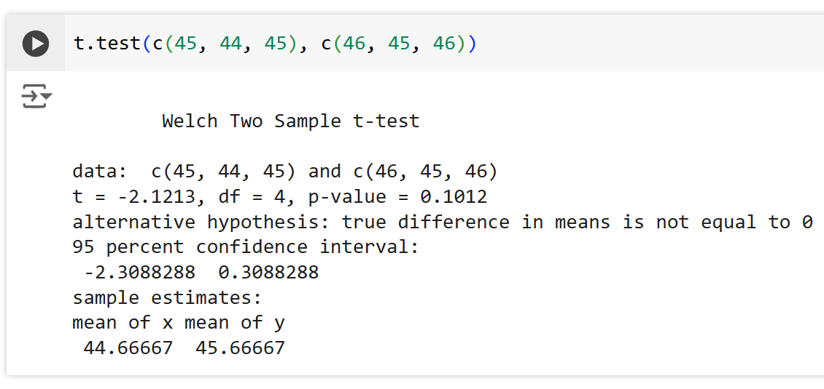
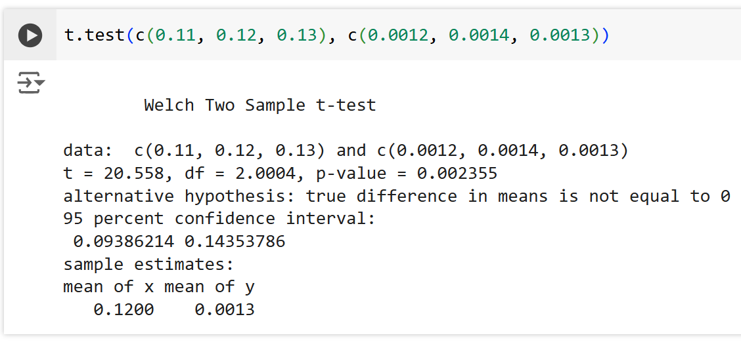
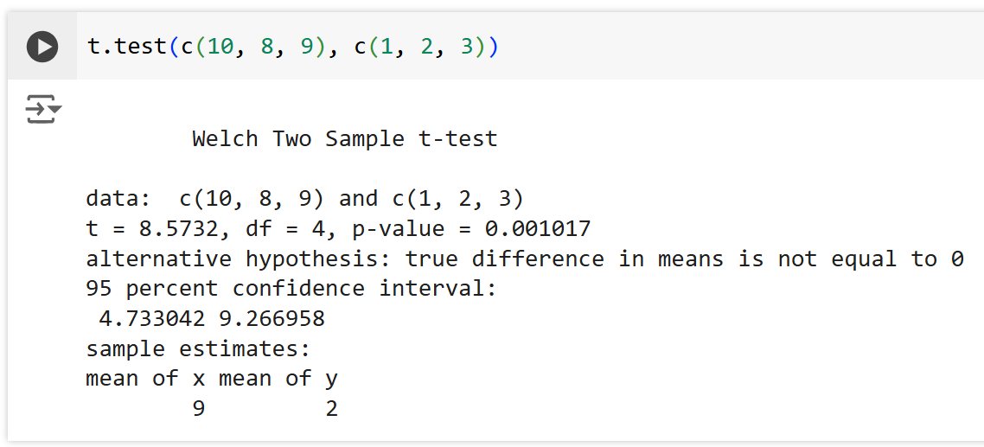
Differential Gene Expression
Gene | Sample 1 Healthy | Sample 2 Healthy | Sample 3 Healthy | Sample 4 Tumor | Sample 5 Tumor | Sample 6 Tumor
A | 100 | 101 | 105 | 160 | 163 | 154
B | 10 | 8 | 9 | 1 | 2 | 3
C | 45 | 44 | 45 | 46 | 47 | 46
D | 0.11 | 0.12 | 0.13 | 0.0012 | 0.0014 | 0.0013
Gene A
Gene D
Gene B
Gene C

Slide 21
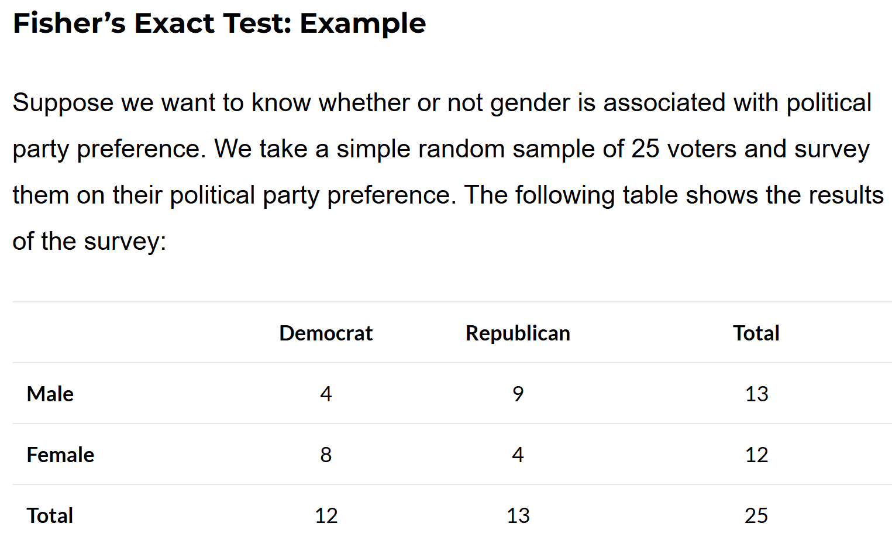
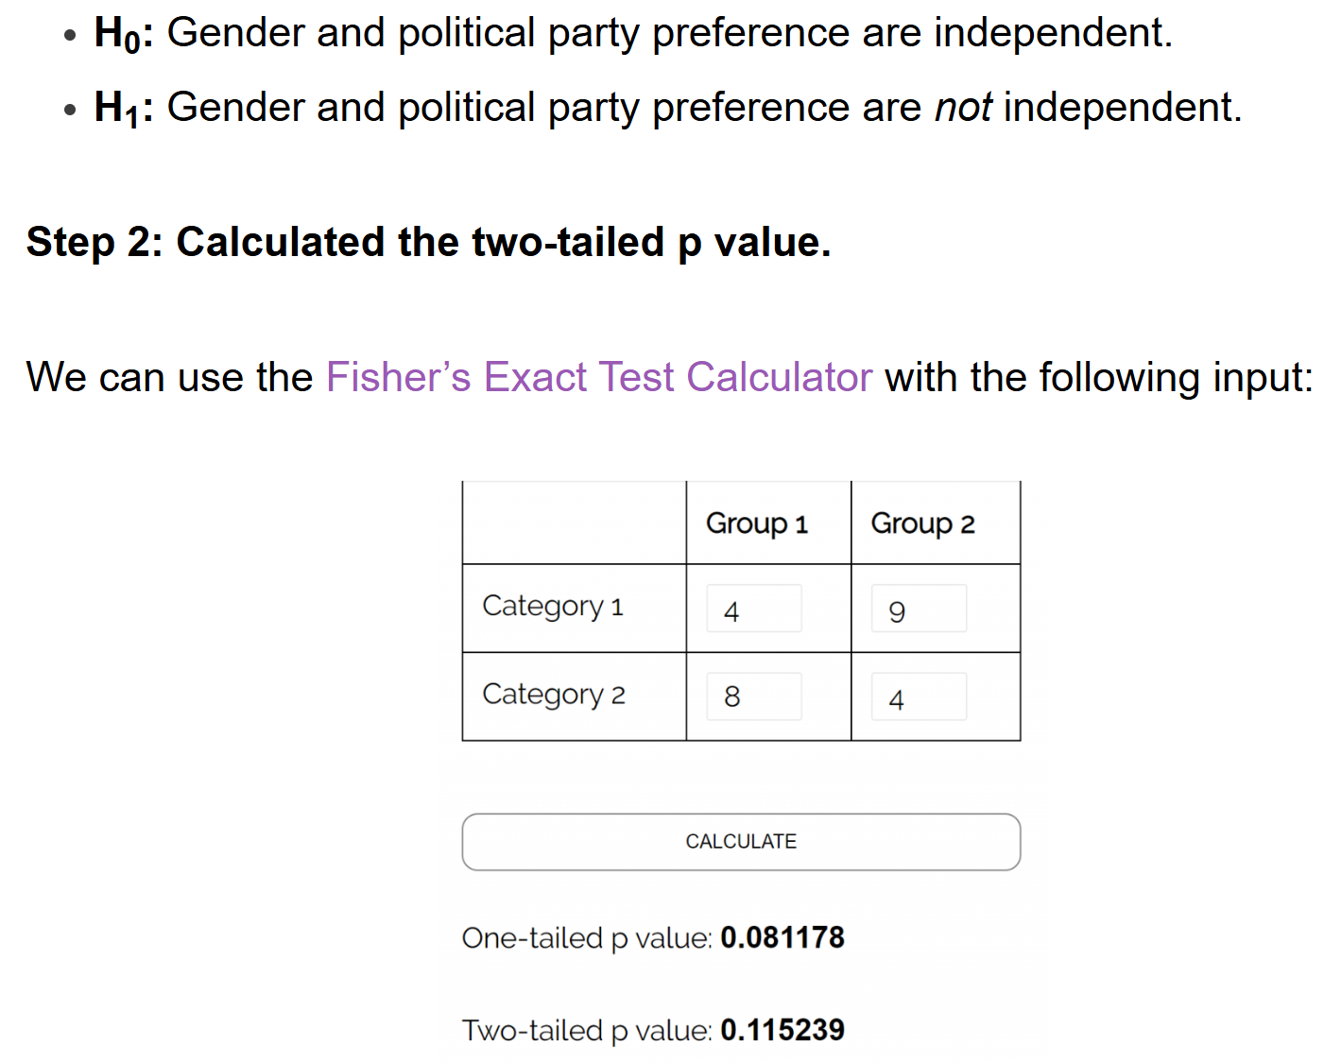
https://www.statology.org/fishers-exact-test/

Slide 22
Enrichment of DEGs with Over Representation Analysis (ORA)
https://decoupler-py.readthedocs.io/en/latest/notebooks/msigdb.html

Slide 23
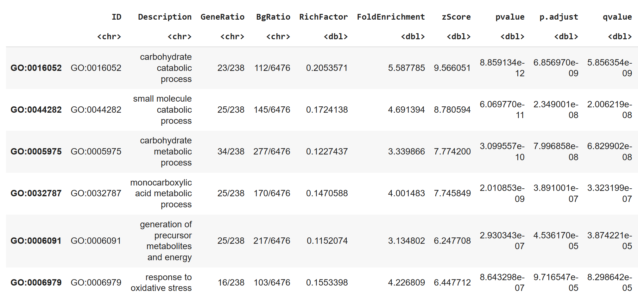
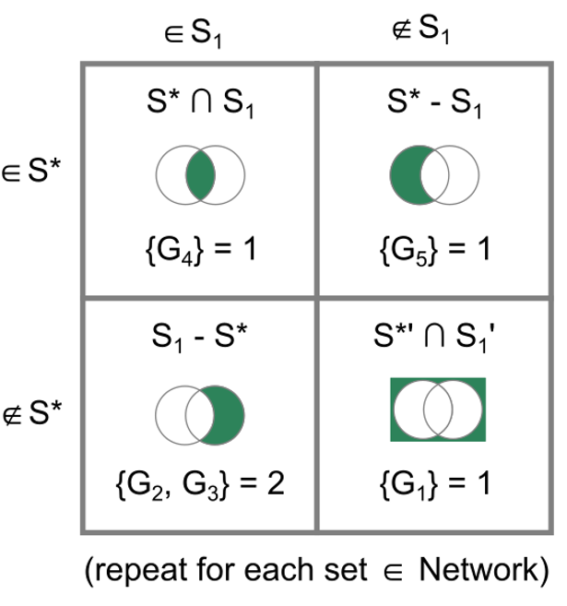
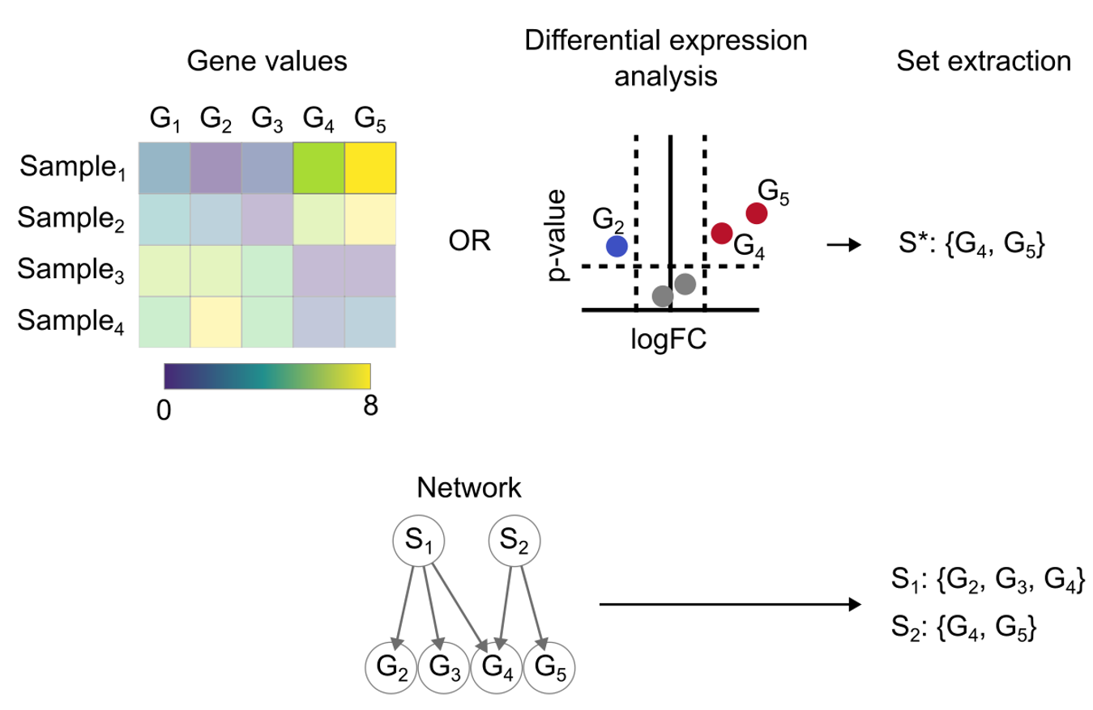
Enrichment of DEGs with Over Representation Analysis (ORA)
https://decoupler-py.readthedocs.io/en/latest/notebooks/msigdb.html

Slide 24
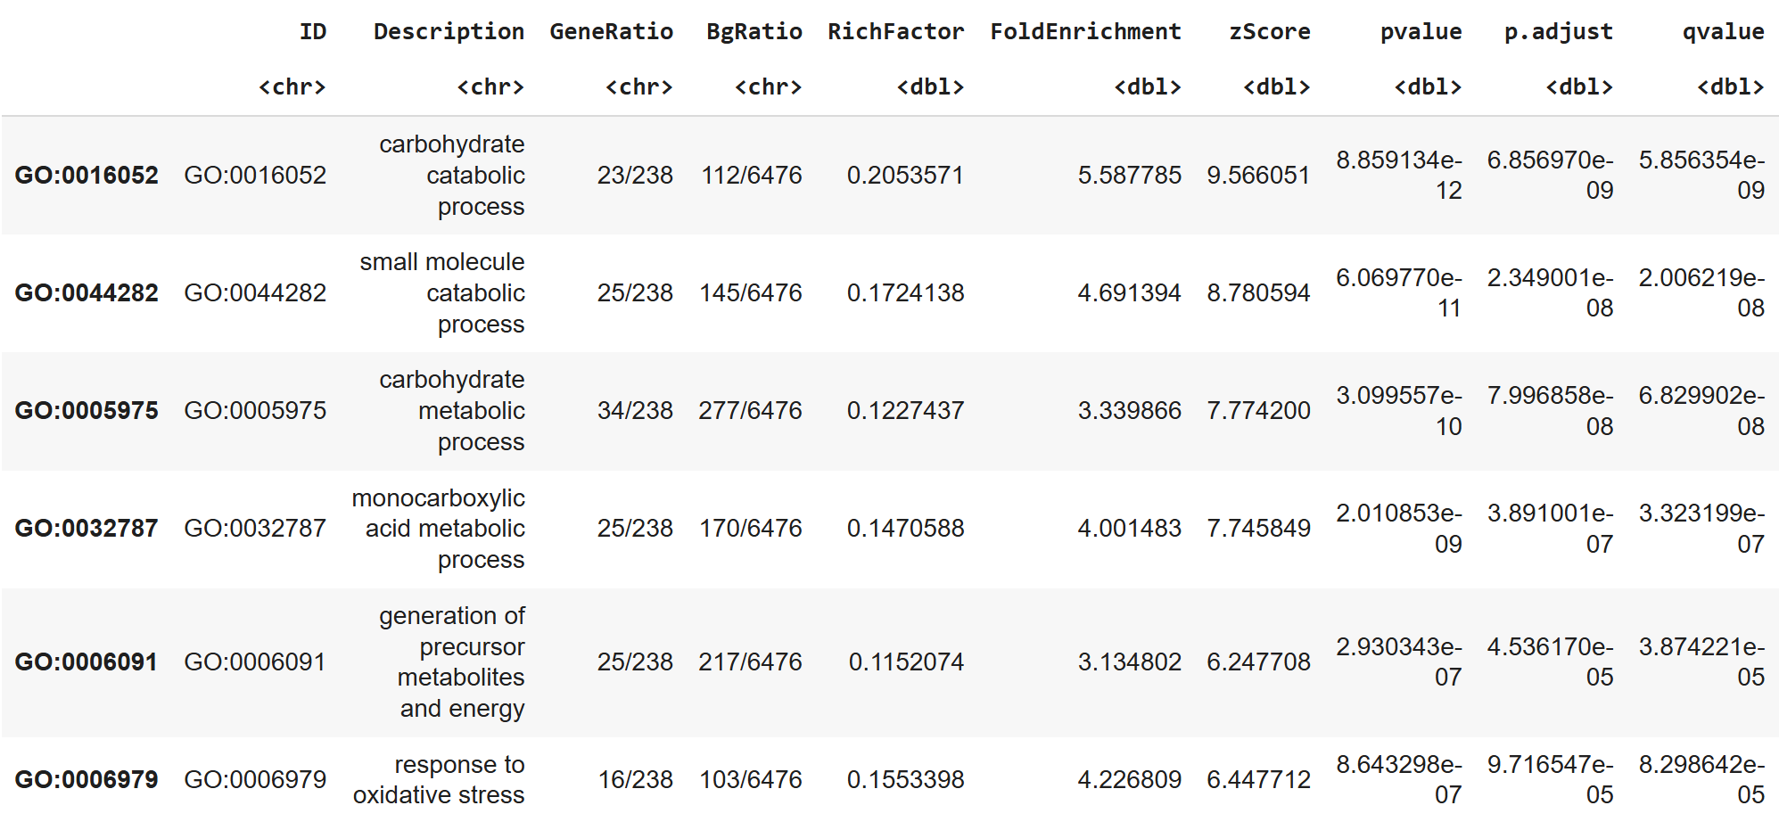
Enrichment of DEGs with Over Representation Analysis (ORA)
The qvalue in the results table from enrichGO represents the adjusted p-value for multiple testing correction. It is typically calculated using the False Discovery Rate (FDR) method, which controls the proportion of false positives among the list of enriched terms.
https://colab.research.google.com/drive/1uvY0IK2Dl75L61A0KEkXAIad3DDaEOMp?usp=sharing

Slide 25
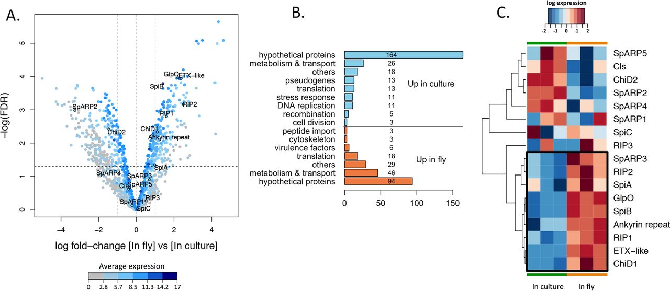
Exercise 1: Explain the below figure
https://journals.asm.org/doi/10.1128/mbio.00024-18

Slide 26
Exercise 1: Explain the below figure
FIG 3 (A) Volcano plot of differential gene expression of S. poulsonii in host versus in culture. Each point represents the average value of one transcript in three replicate experiments. The expression difference is considered significant for a log2 fold change of ≥1 (outer light gray broken vertical lines) and for a P value of ≤0.05 [−log(FDR) of ≥1.3, dark broken horizontal line]. Points are colored according to their average expression in all data sets. Names and outlined points represent virulence factors. FDR, false-discovery rate. (B) Manual clustering of the transcripts differentially expressed by S. poulsonii in the fly versus in the culture. The numbers of sequences in the different categories are indicated on the bars or to the right of the bars. (C) Heatmap of S. poulsonii virulence gene expression. Each column represents the value for one replicate experiment in culture or in the fly. The colors represent the log10 level of expression in the corresponding experiment. The cluster of genes that are induced when S. poulsonii is in the host (versus in vitro) is shown enclosed in a black box. SpARP5, S. poulsonii ARP5.
https://journals.asm.org/doi/10.1128/mbio.00024-18

Slide 27
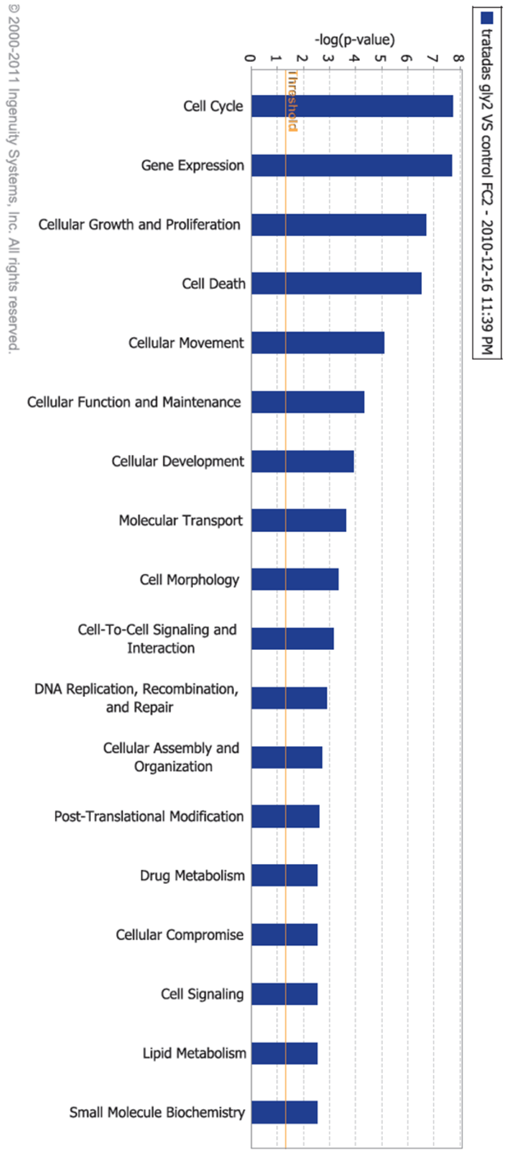
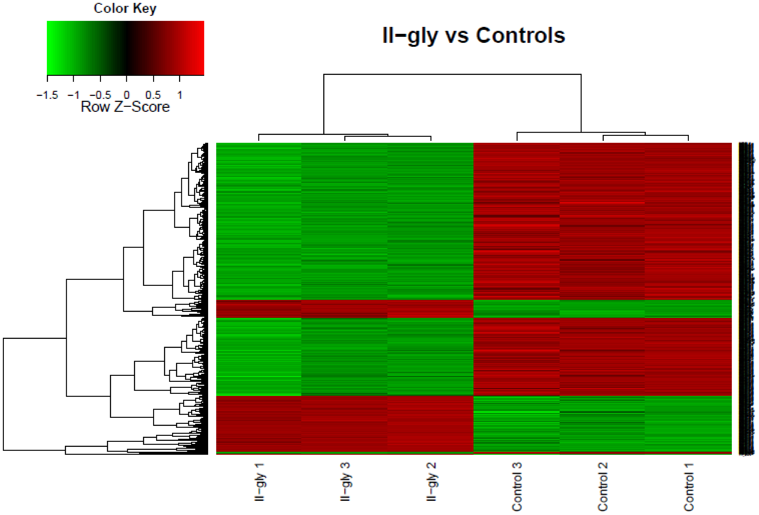
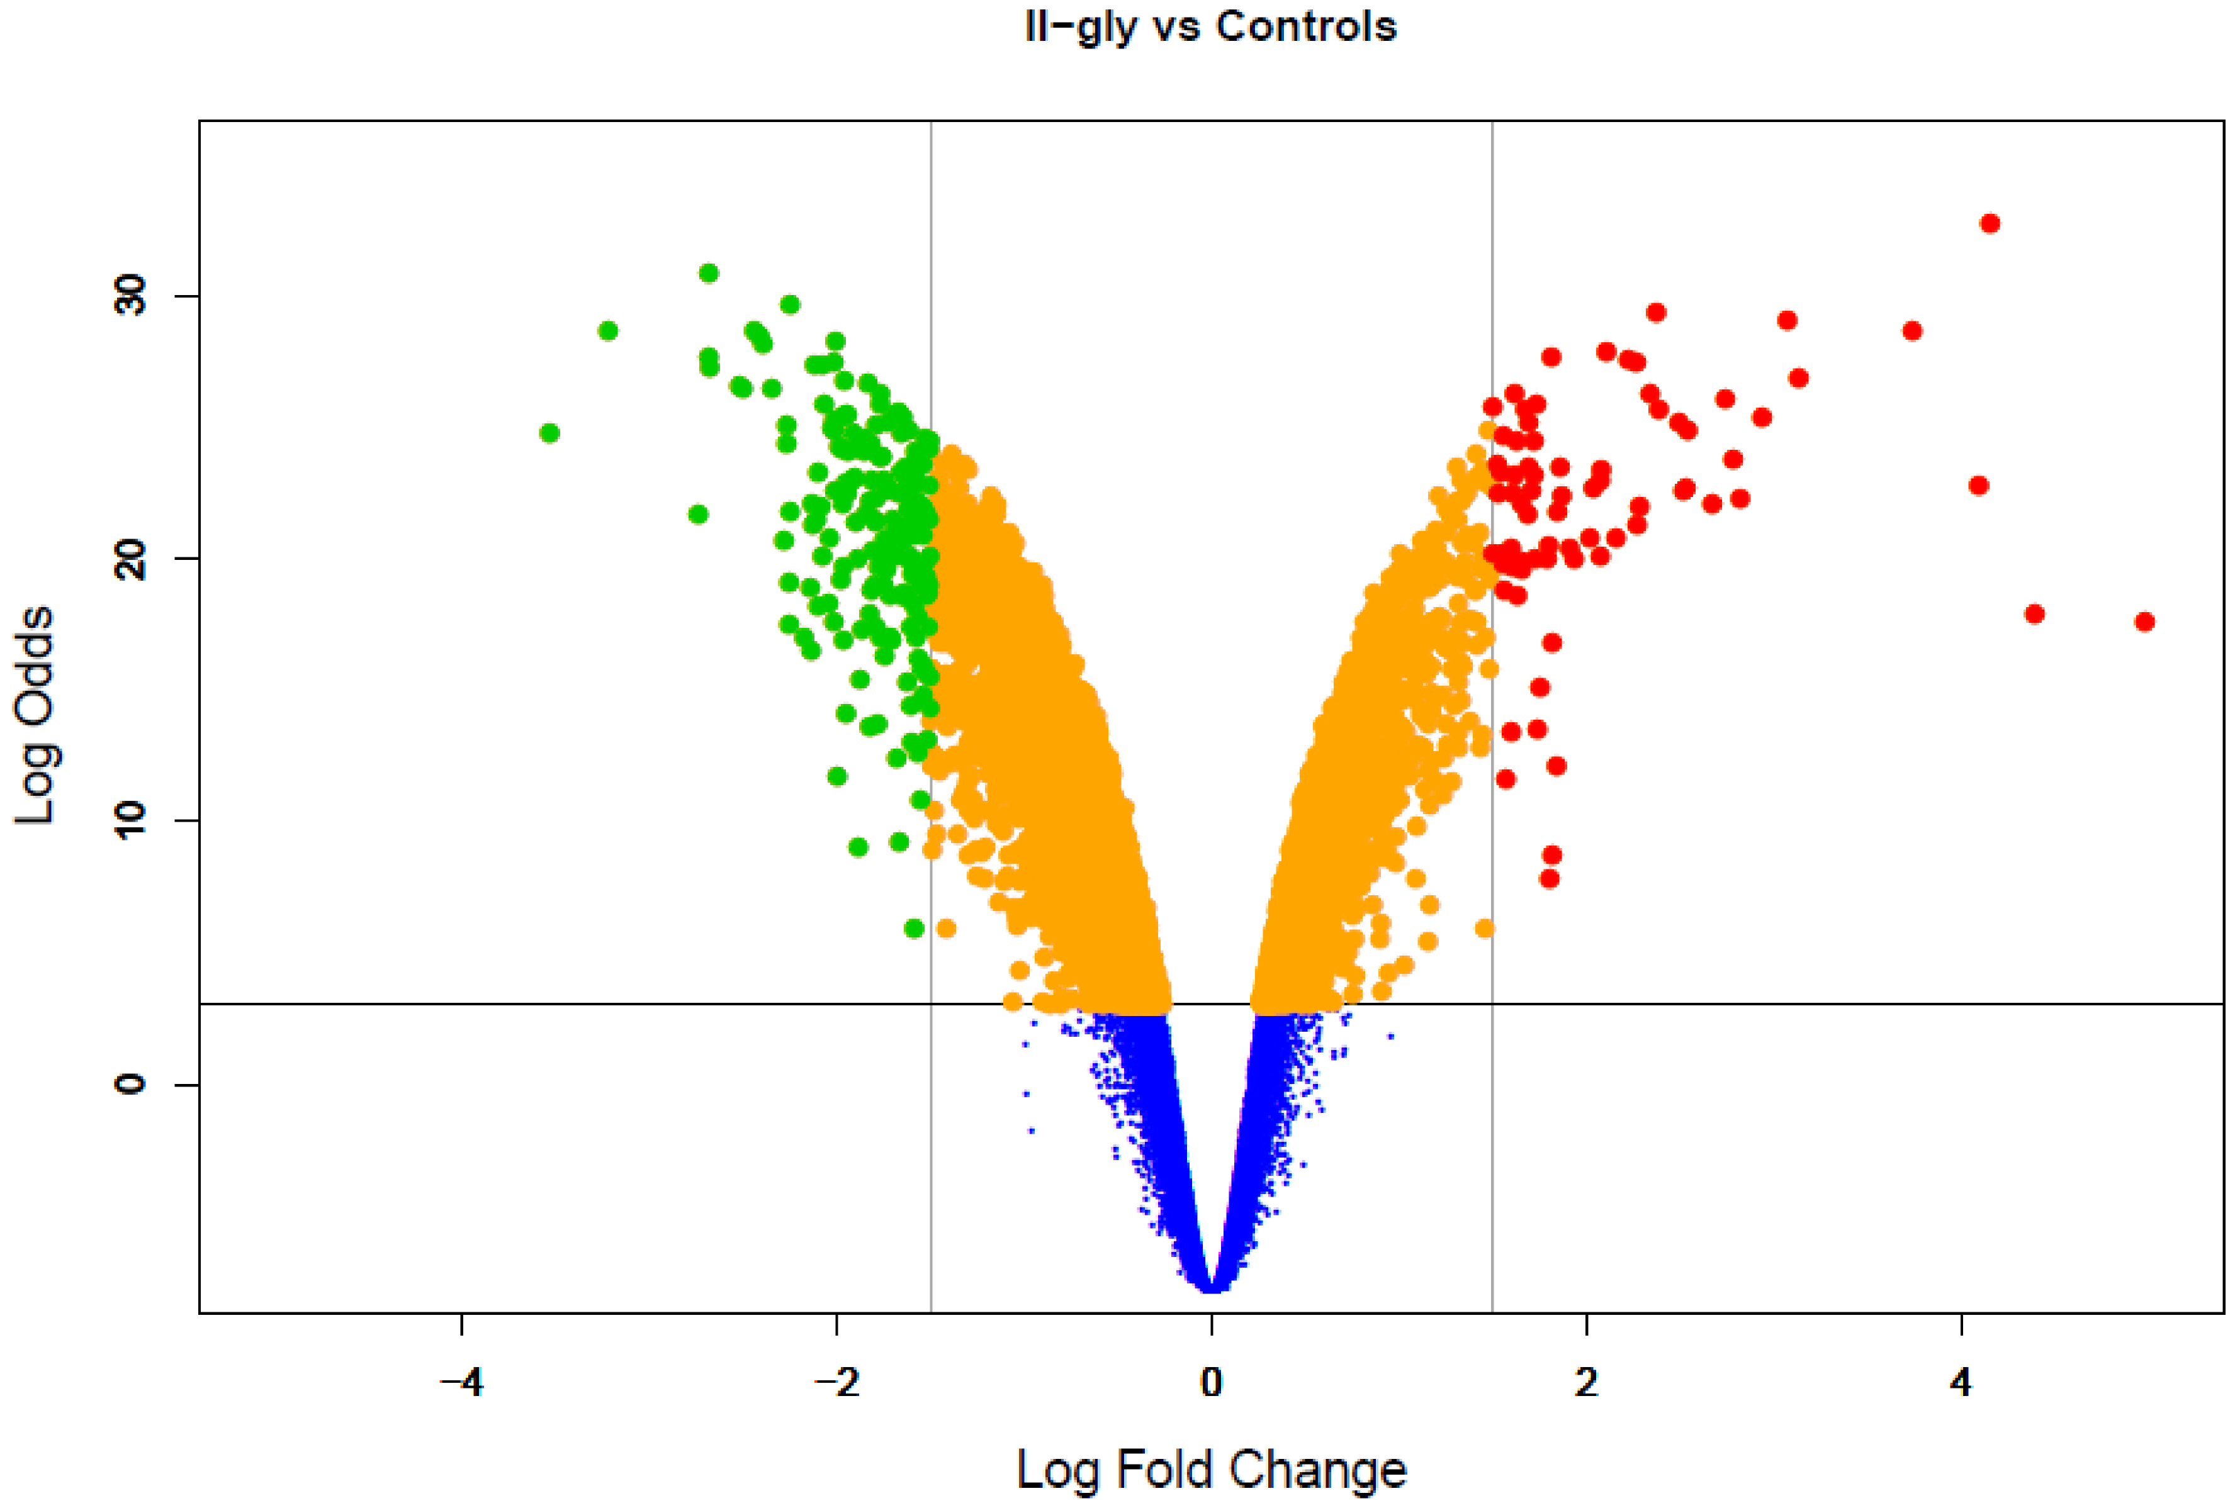
Exercise 2: Explain the below figure
https://doi.org/10.1371/journal.pone.0054664

Slide 28
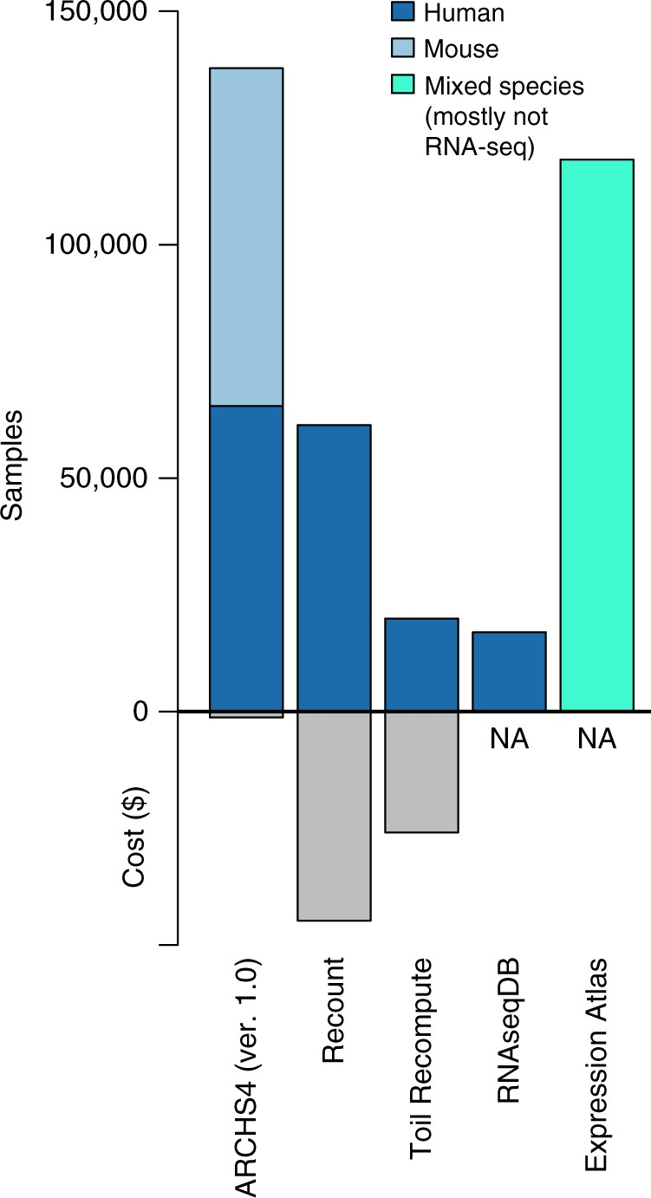
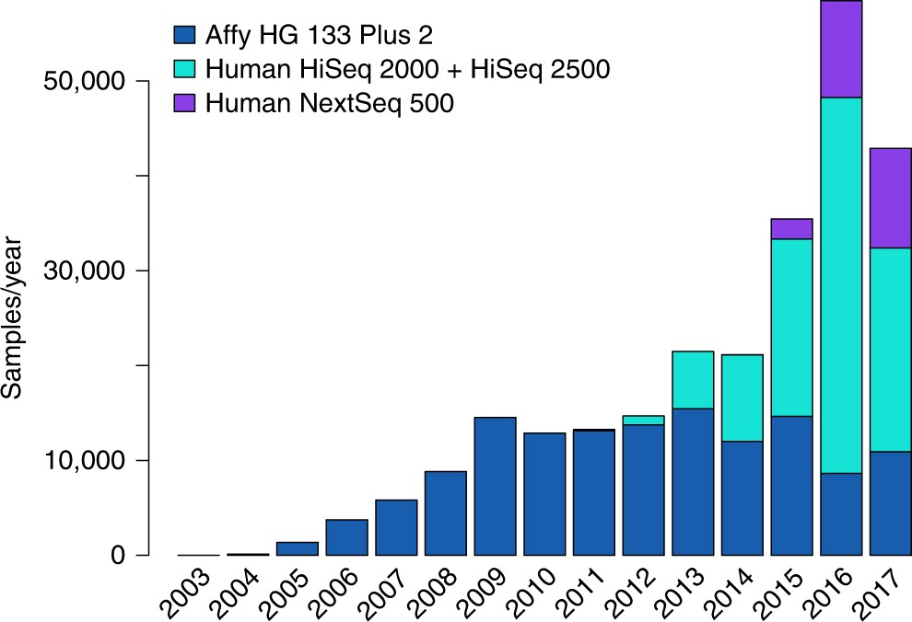


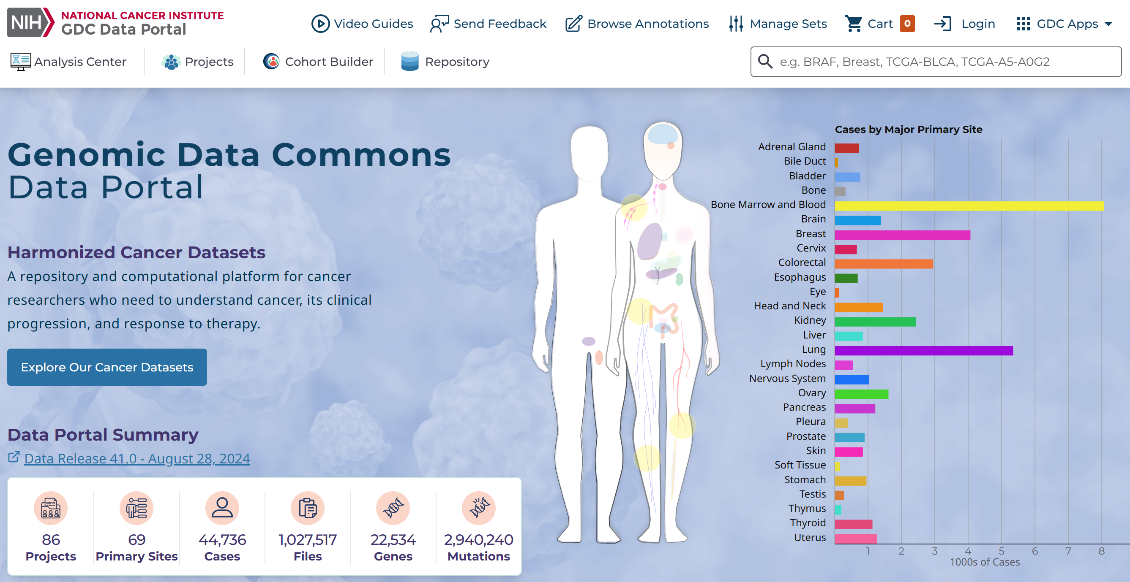
RNA-seq databases: GTEx and TCGA
https://gtexportal.org/home/
https://www.nature.com/articles/s41467-018-03751-6

Slide 29
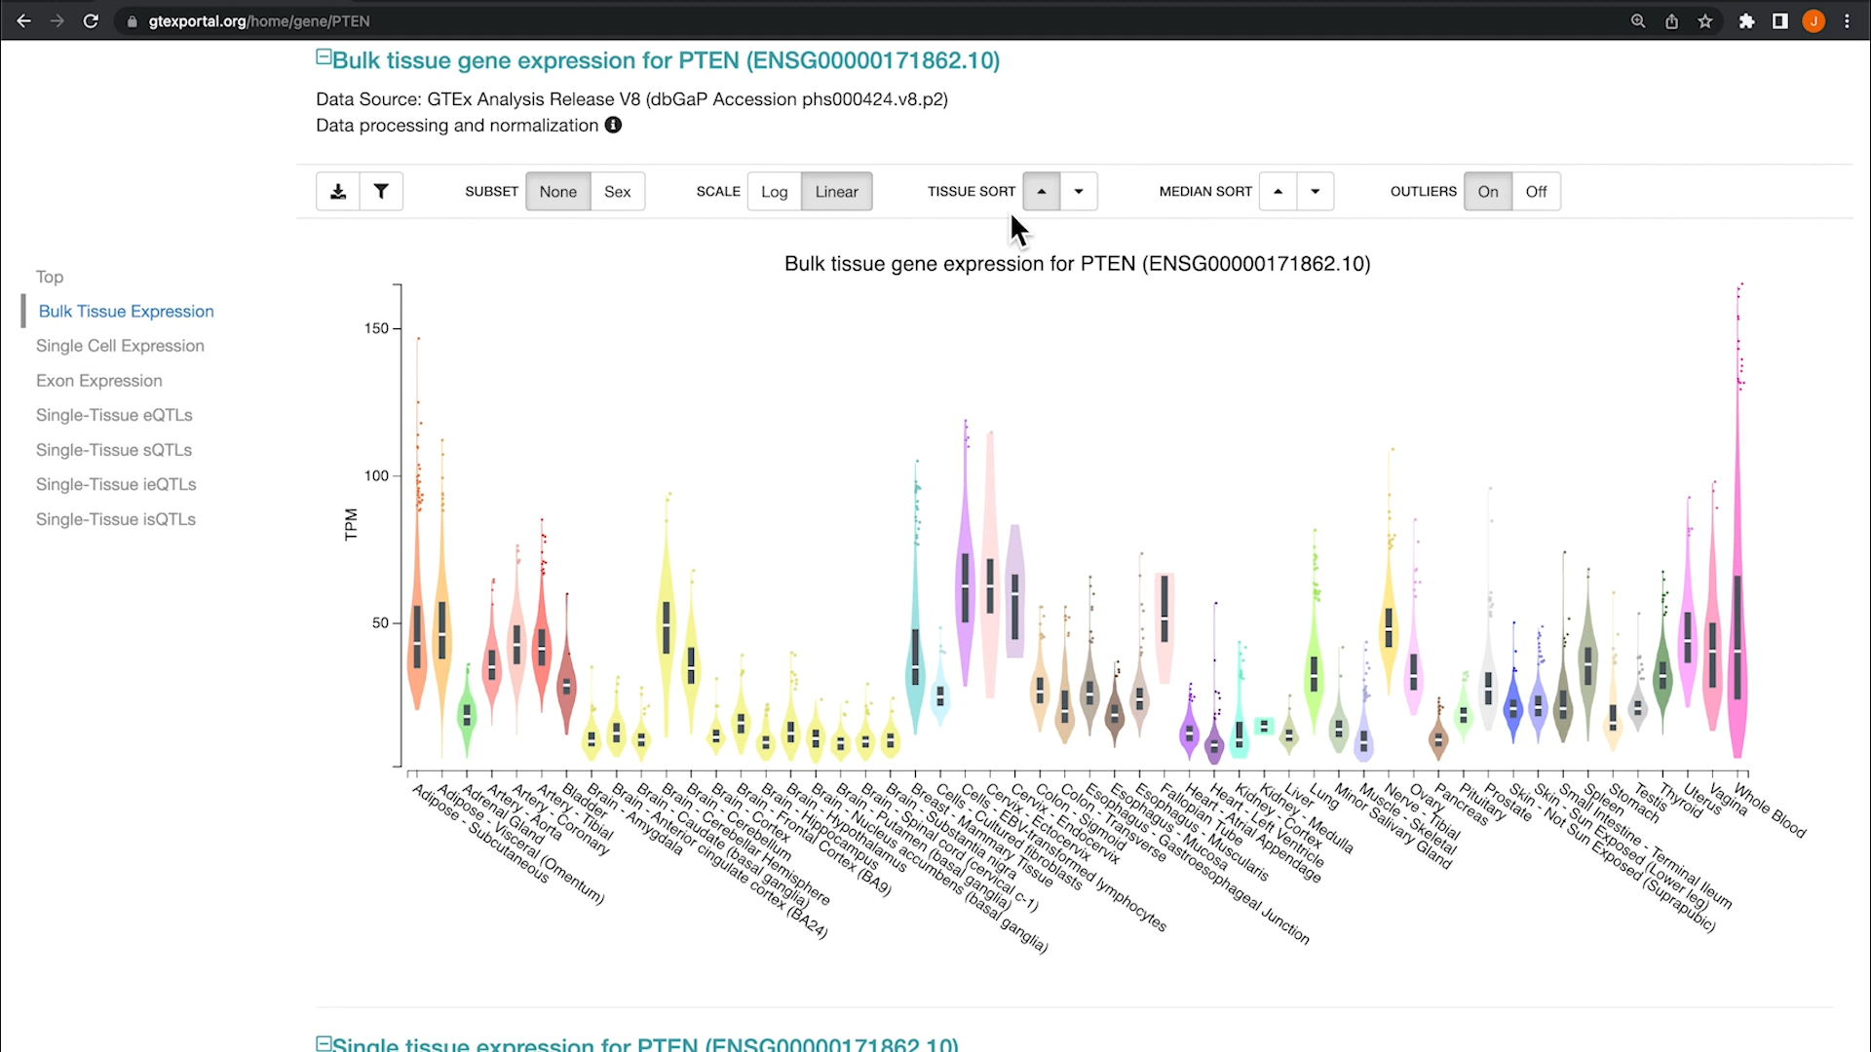
https://www.youtube.com/watch?v=WjHkb_y_yFk&t=2s
https://gtexportal.org/home/

Slide 30
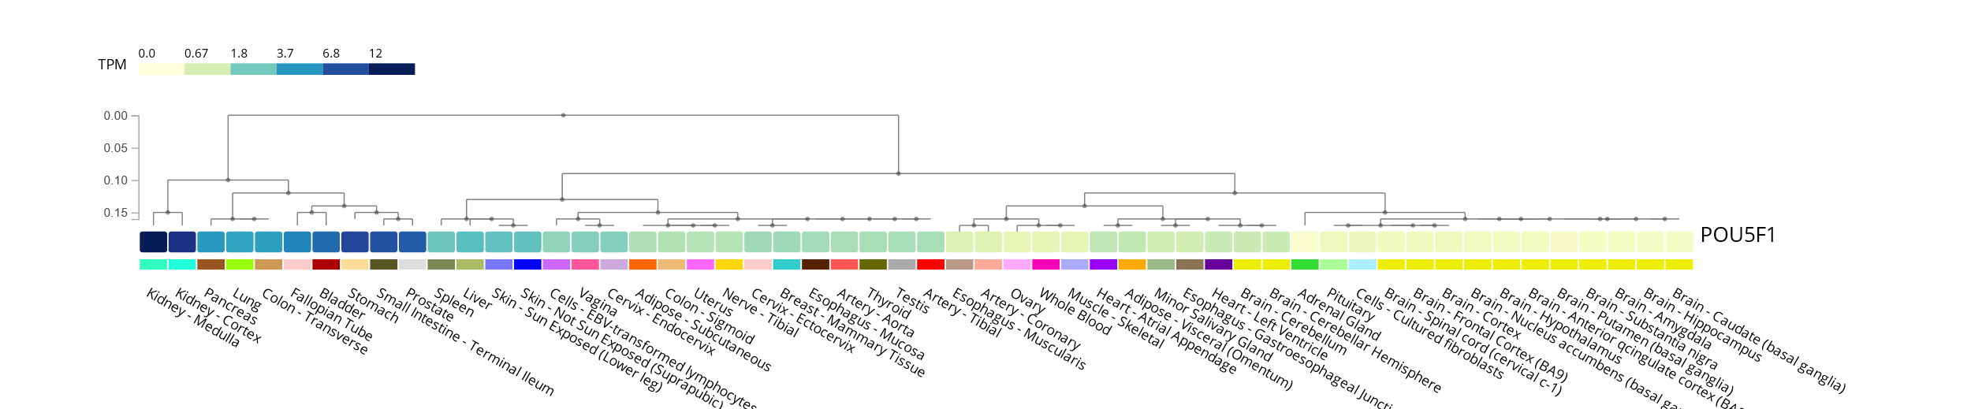
https://www.gtexportal.org/home/multiGeneQueryPage/POU5F1

Slide 31
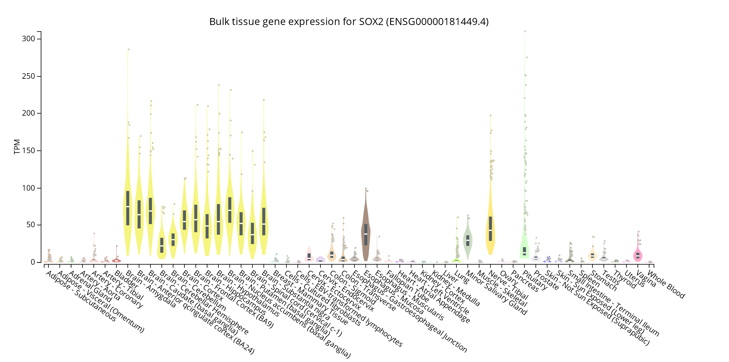
https://www.gtexportal.org/home/gene/SOX2#geneExpression

Slide 32
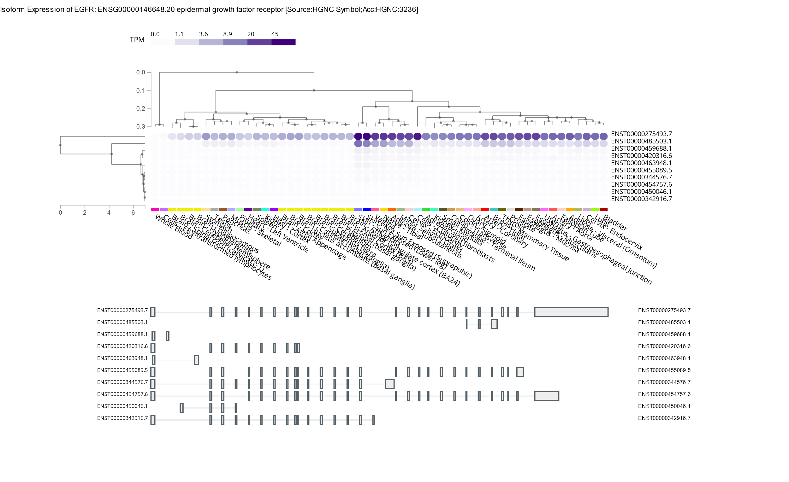
https://www.gtexportal.org/home/transcriptPage

Slide 33
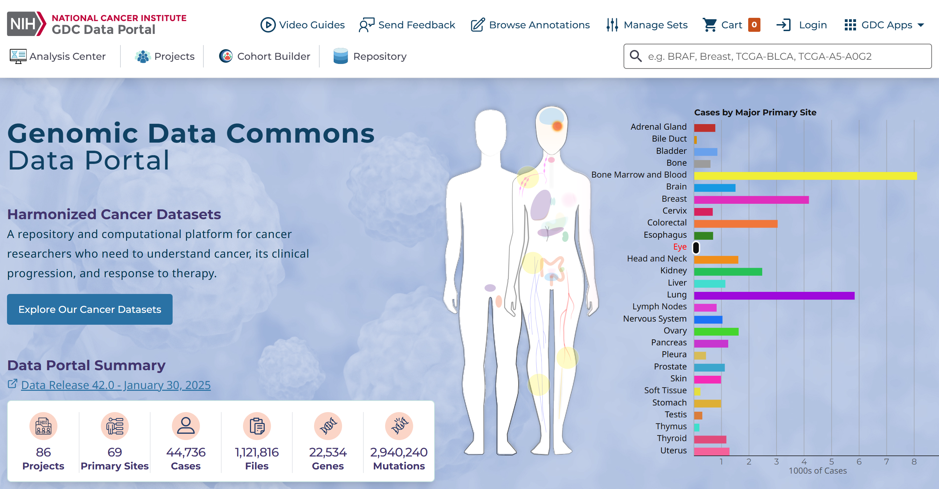
https://portal.gdc.cancer.gov/

Slide 34
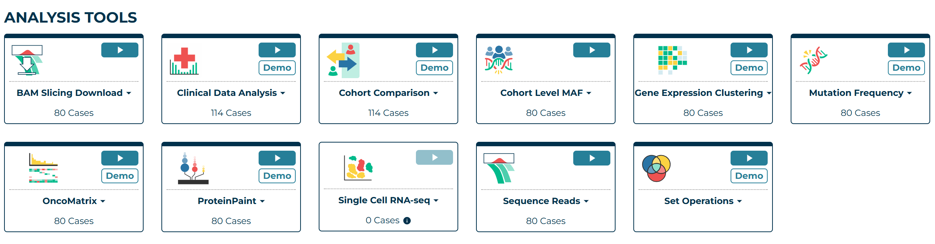
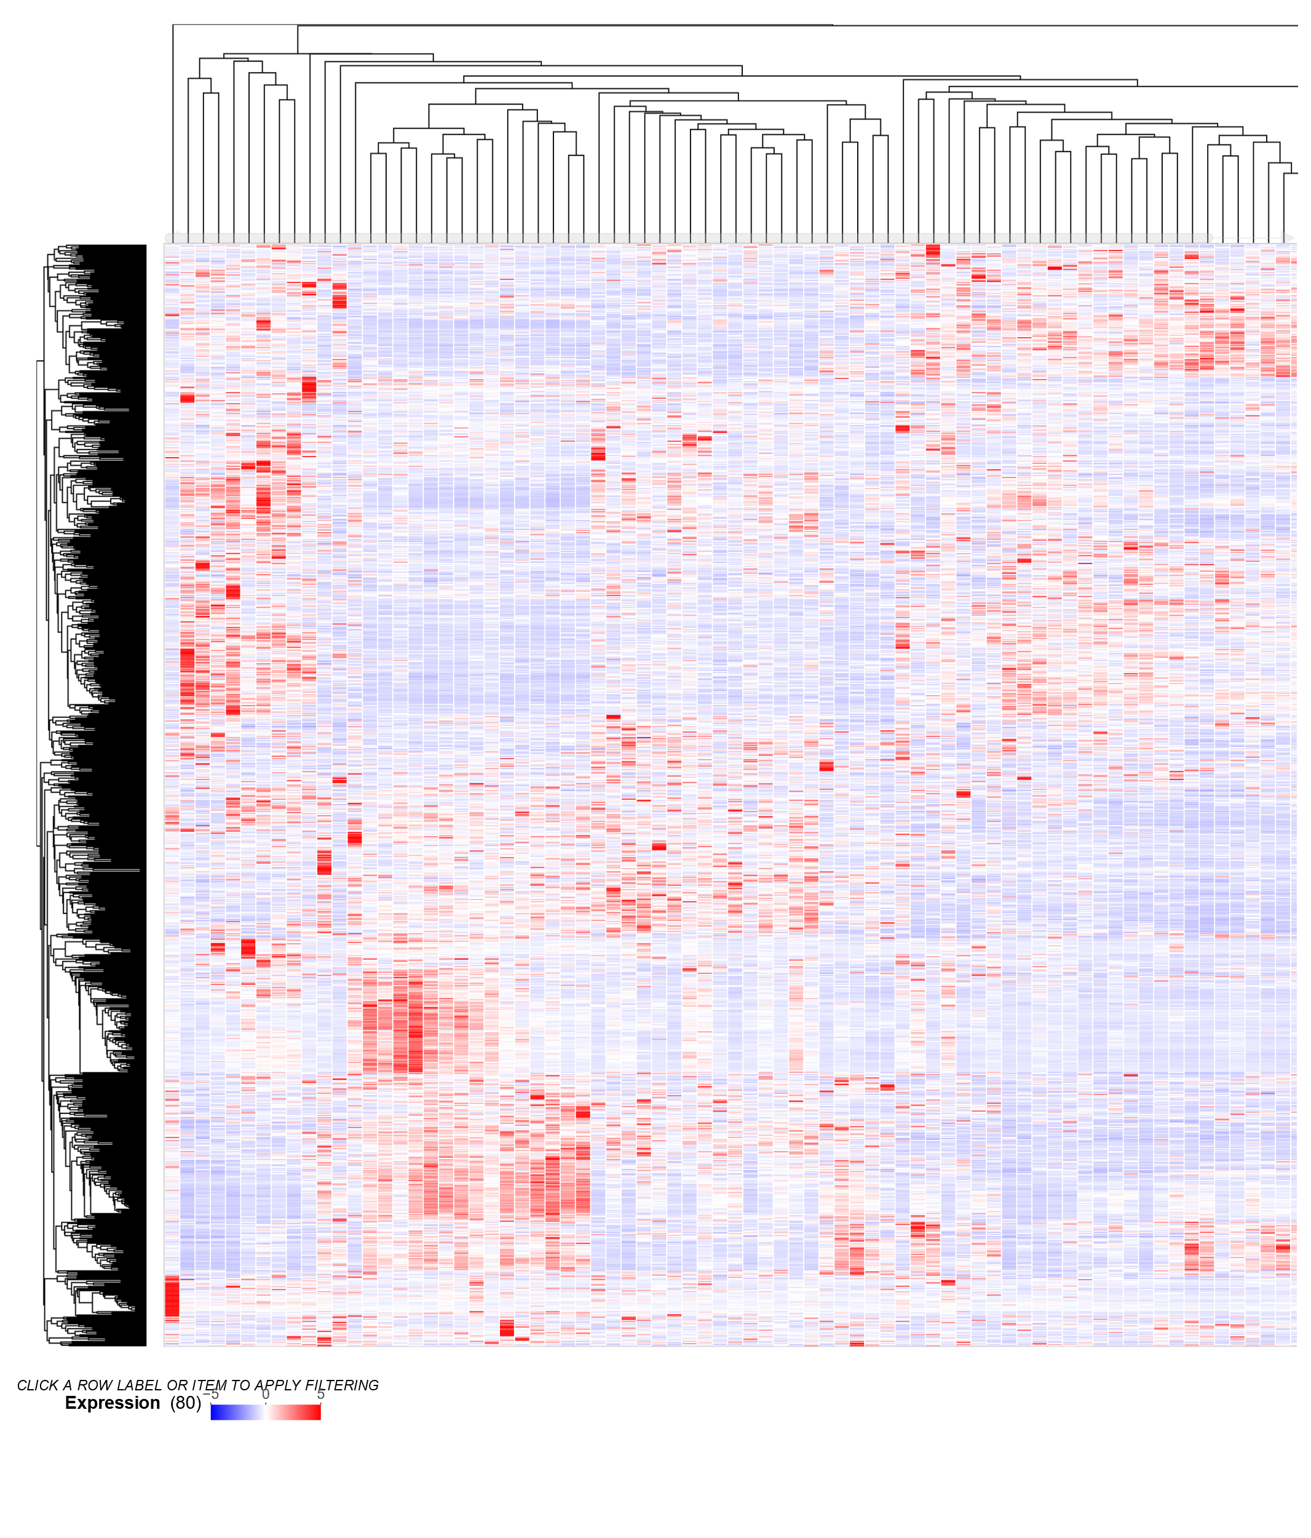
https://portal.gdc.cancer.gov/analysis_page?app=GeneExpression

Slide 35
Cảm ơn các thầy cô và các bạn!
Ngày 10 tháng 05 năm 2025
TS. Lưu Phúc Lợi
Email: luu.p.loi@googlemail.com
Zalo: 0901802182

